Slide 1
Science for Life Laboratory
Introduction to Bioinformatics using NGS data, May 15-17 2017, Göteborg
SciLifeLab: a brief introduction
Elina Staaf
Project coordinator

Slide 2
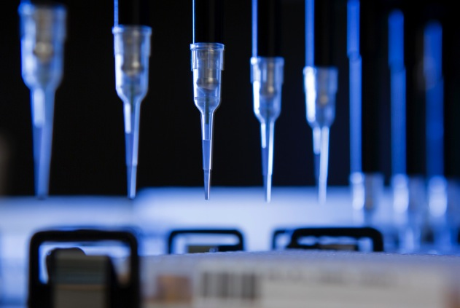
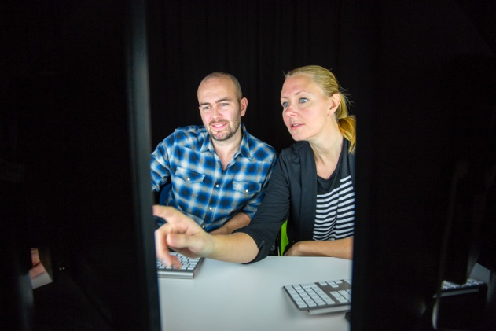

4 host universities
Established in 2010
National resource since 2013
More than 1000 researchers

Slide 3
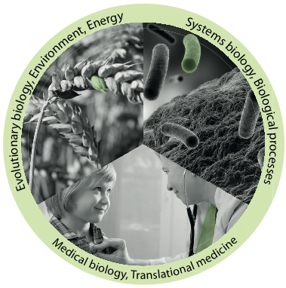
Vision
To be an internationally leading center that develops, uses and provides access to advanced technologies for molecular biosciences with focus on health and environment

Slide 4
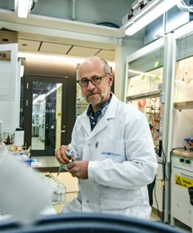
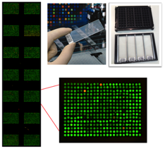
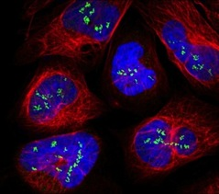
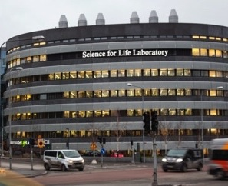
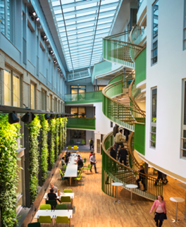
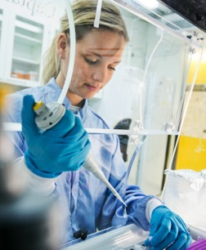
Mission
Technology platforms for national use
Service to research community
Technology development
Education
Strong research community
Strong interdisciplinary community
SciLifeLab Fellows Program
National projects
Society impact
Health care outcome
Environment
Tech transfer, spin-offs, industry collaborations

Slide 5

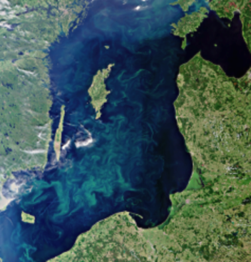
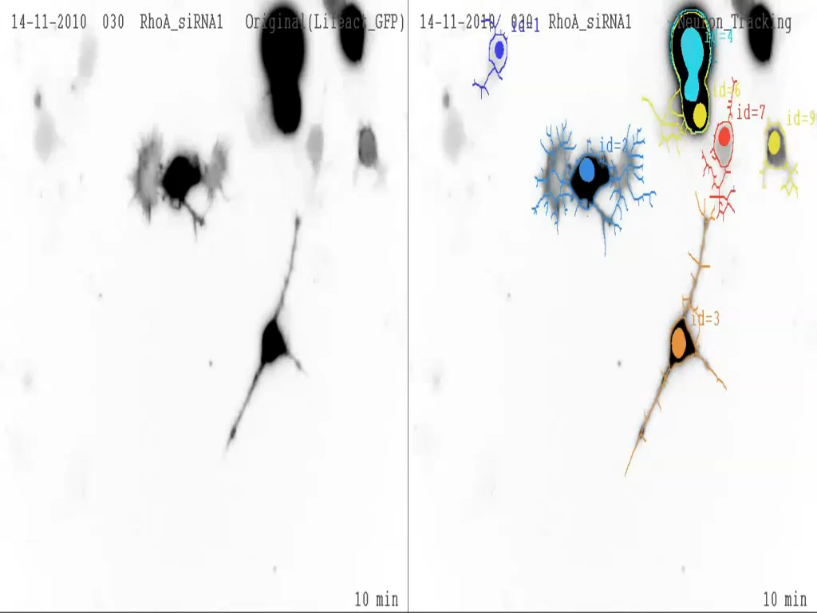
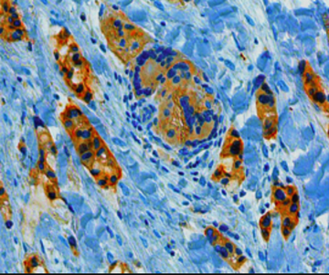
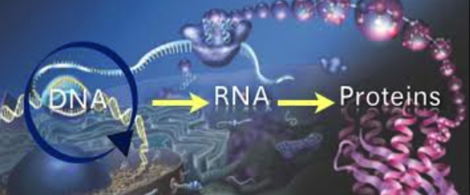
The range of life sciences studied
Ecosystems
Communities
Populations
Organisms
Organs
Tissues
Cells
Organelles
Molecules

Slide 6
Platforms and facilities

Slide 7
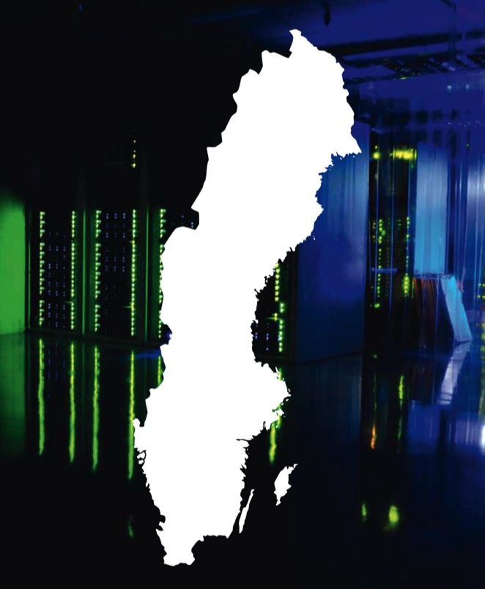
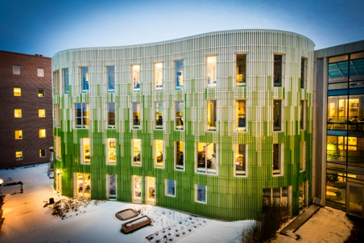
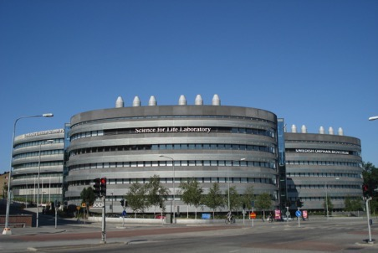
Nodes and sites
Uppsala node
Umeå
Stockholm node (Solna)
Linköping
Göteborg
Lund
Notes:
SciLifeLab comprises technologies and competence at several Swedish Universities outside Stockholm and Uppsala:
Linköping University
Gothenburg University and Chalmers
Lund University
Umeå University
Swedish University of Agricultural Sciences Umeå

Slide 8
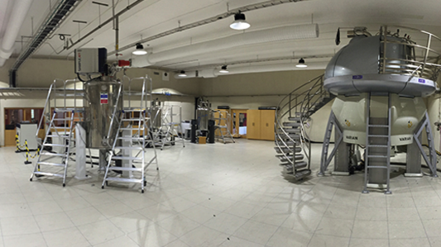
Gothenburg - University of Gothenburg and Chalmers
3 facilites
Systems Biology, Chalmers Head: Jens Nielsen, Thomas Svensson
Integrative Clinical Genomics, GU Head: Tommy Martinsson
Swedish NMR Centre, GU Head: Göran Karlsson
1 SciLifeLab National Fellow
Aleksej Zelezniak, Chalmers.
6 SciLifeLab National Projects
Notes:
1 fellow in 2015
in Systems Medicine announced, Chalmers: Aleksej Zelezniak, 20% from November 2016, 100% from May 2017
National projects in Gothenburg:
6 in total, all at GU
2 within genomics – PIs: Tommy Martinsson, Jonas Nilsson
4 within biodiversity - PIs: Anders Blomberg, Roger Bultin, Alexandre Antonelli, Anna Godhe

Slide 9
Platforms and facilities

Slide 10

www.nbis.se

Slide 11
Why bioinformatics infrastructure?
A continuous technical scale‐up will provide an unprecedented amount of heterogeneous omics data
- Support, Tools, Training
System‐level analyses in biomedical research will transform life science
- Strategic positioning in systems biology
Large‐scale omics is will make a major leap into translational research and diagnostics
- Method adaptation and expert advice
Notes:
remarkable

Slide 12
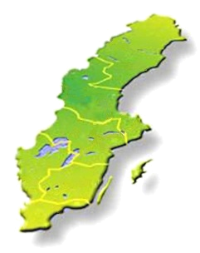
User access to NBIS
Study design consultation
Short & medium-term support
800 SEK/hour
http://www.nbis.se/support/supportform/index.php
Apply anytime
Long-term support (500h; free: scientific evaluation) http://www.scilifelab.se/facilities/wabi/
Next deadline: May 5th
Compute and storage (free; majority of hardware and system administration belongs to SNIC)
Apply: https://supr.snic.se
Read more: http://www.uppmax.uu.se/

Slide 13
Bioinformatics Drop-In
Are you planning a project and need someone to discuss the bioinformatics analysis with?
Do you need bioinformatics support, but do not know who to turn to?
Are you stuck in your own bioinformatics project and need help?
Meet the NBIS staff at bioinformatics drop-in
Similar activities in the other NBIS nodes/cities
Uppsala
When: Weekly on Thursdays
at 10-11 am
Where: SciLifeLab, level 3
Stockholm
When: Weekly on Tuesdays
at 10.30-11.30 am
Where: SciLifeLab, gamma, level 6

Slide 14
Upcoming courses autumn 2017
Date | Course
Sep 11-15 | Perl programming with application to Bioinformatics
Sep 25-29 | Introduction to Bioinformatics using NGS data, Lund
Oct 23-27 | R Programming Foundations for Life Scientists
Nov 6-8 | RNA-seq
Nov 15-17 | De novo Genome Assembly
Nov 20-22 | Metagenomics
Nov 27 – Dec 1 | Introduction to Bioinformatics using NGS data, Uppsala
Application Nov/Dec | The Swedish Bioinformatics Advisory Program
See also: https://www.scilifelab.se/education/courses/

Slide 15
Upcoming courses autumn 2017
Date | Course
Sep 11-15 | Perl programming with application to Bioinformatics
Sep 25-29 | Introduction to Bioinformatics using NGS data, Lund
Oct 23-27 | R Programming Foundations for Life Scientists
Nov 6-8 | RNA-seq
Nov 15-17 | De novo Genome Assembly
Nov 20-22 | Metagenomics
Nov 27 – Dec 1 | Introduction to Bioinformatics using NGS data, Uppsala
Application Nov/Dec | The Swedish Bioinformatics Advisory Program
See also: https://www.scilifelab.se/education/courses/

Slide 16
The Swedish Bioinformatics Advisory Program
A new teaching model, where PhD students get a senior bioinformatician as a personal advisor during 2 years of their PhD.
Monthly project meetings + two grand meetings per year to aid networking and knowledge transfer.
First call late 2014:
>50 applicants for 15 places
Last call in 2016
>111 applicants for 18 places
www.scilifelab.se/education/mentorship/the-swedish-bioinformatics-advisory-program/
Next call Nov-December 2017

Slide 17
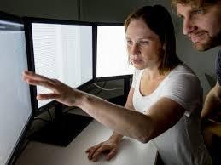
Why this program
Overall aim: Great research in Sweden!
How? Strategic investment in PhD education Complementing PhD supervisors with technical expertise
Catalyze transition to large-scale data analyses
The PhD student is responsible to prepare and drive the meetings!

Slide 18

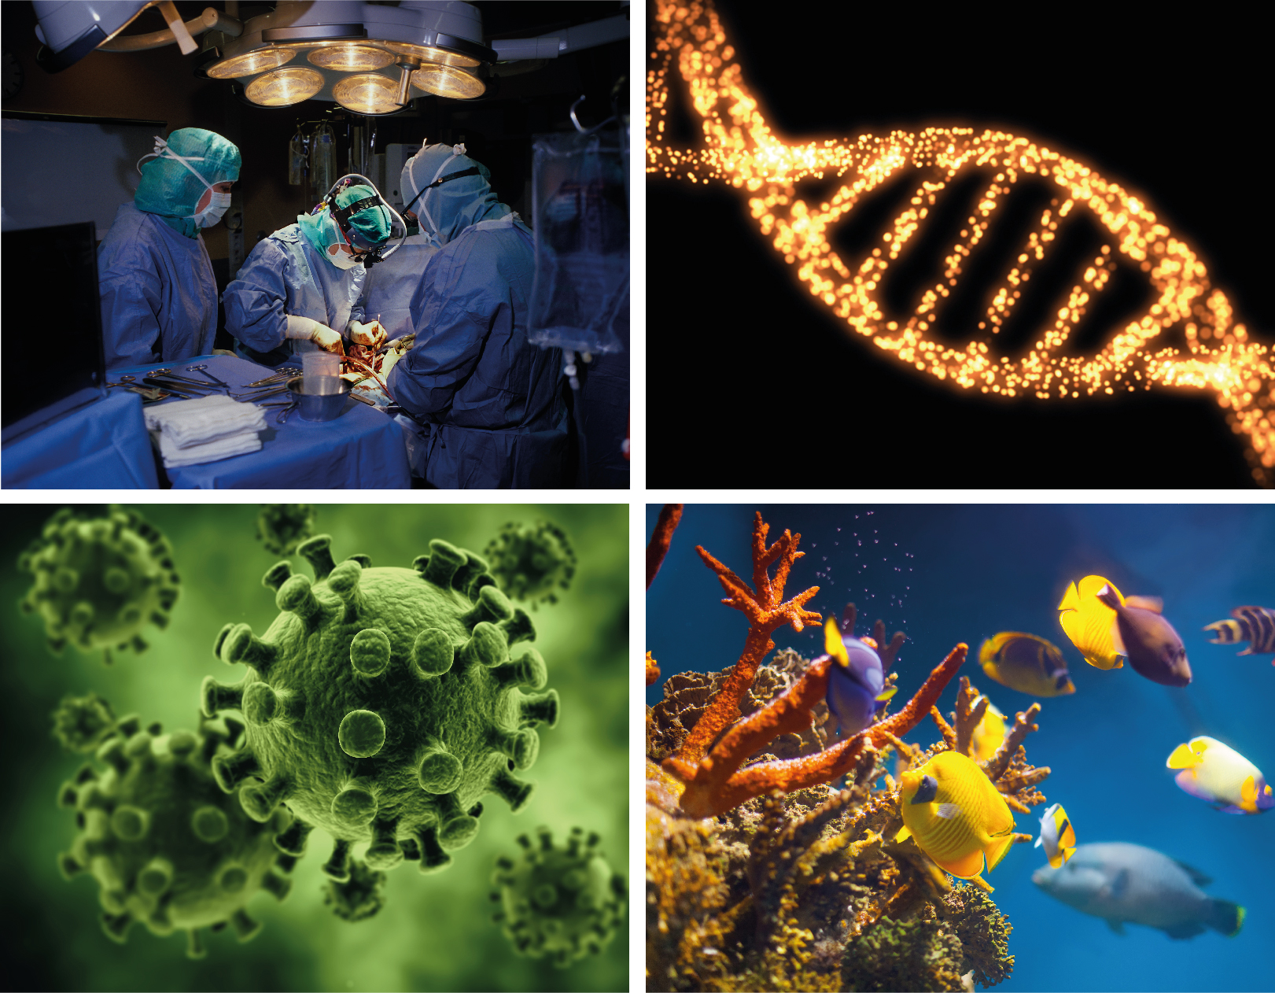
Science & SciLifeLab Prize
A grand prize winner receives a prize of US $30,000; and each of the three category winners will receive US $10,000
The grand prize winning essay will be published in Science and essays from the three category winners will be published online
“to incent our best and brightest to continue in their chosen fields of research”
Notes:
Cell and Molecular Biology
Ecology and Environment
Genomics and Proteomics
Translational Medicine

Slide 19
Also of interest to you
SciLifeLab The Svedberg seminar series
PhD student course (1 credit for 10 occasions)
Every other Monday 15.15 at BMC, Uppsala
Invites leading scientist from worldwide - field of bioscience
Open for all to attend!
Roadshows, Open House, Mini-symposia
Scientific workshops and conferences
NGS, single cell, microscopy, epigenetics and chromatin etc
https://www.scilifelab.se/education/seminars-and-symposia/
Notes:
We also organise and host many other community building activities such as...
Also we go on road shows to other universities in Sweden and we also have open house so that the researchers can come an visit our labs.
-the yearly conference SciLifeLab science summit (this years theme was single cell analyses- from microbes to human brain).
Single Cell analyses – from microbes to human brain

Slide 20
Practical information for the course
Attendance sheet
- Please sign morning and afternoon
Fika and lunches together every day
10, 12:00, 15
Fika outside the lecture hall
Course dinner
- Wed 17/5, at 18:00, Taverna Averna
Sign up latest today before lunch
Included: pre-ordered menu, 1 drink
Notes:
remarkable

Slide 21
www.scilifelab.se
Elina Staaf
Project Coordinator
elina.staaf@scilifelab.uu.se
070-1679839

